Slide 1
FIRST PASS YIELD (FPY)
Customer Needed Date (CND)
&
Manufacturing Need Date (MND)
Controls Agile & Functional Engineering (CAFÉ)

Slide 2
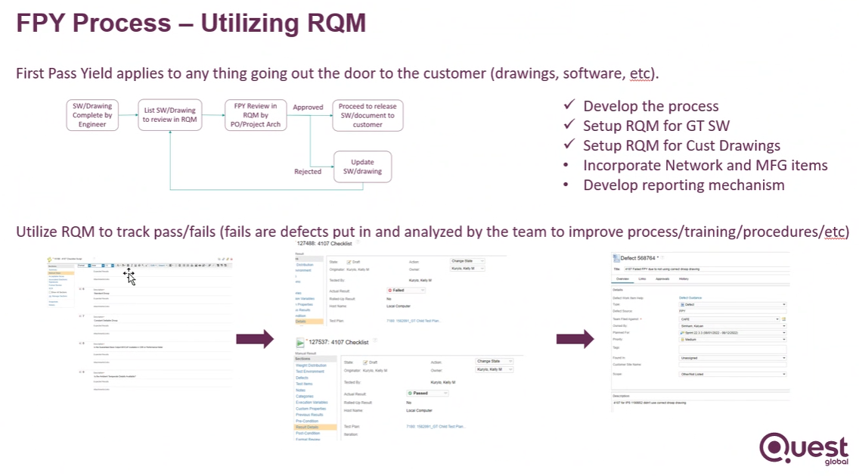

Slide 3
First Pass Yield Help Guide
GT CND & MND tasks will use ETM test suites to measure and track customer delivery quality via First Pass Yield
5475: GT CND Test Suite All
7322: GT MND Test Suite All - CAFE
8144: ST MND Test Suite - CAFE (STC)
8115: Plant MND Test Suite - CAFE (STC)

Slide 4
RQM Review Responsibility Matrix
RQM - CND Review Responsibility
MLI | CAFÉ | Controls Engineer
0330 | X
4107 | X
4444 |  | X
A274P | X
A274S |  | X
A276 |  | X
A312 |  | X
A010S |  | X
0476 |  | X
RQM - MND Review Responsibility
MLI | CAFÉ | Hardware Engineer
A209 |  | X
A204 |  | X
A258 |  | X
HMB2 |  | X
HMB3 |  | X
Q304A |  | X
Q304B |  | X

Slide 5
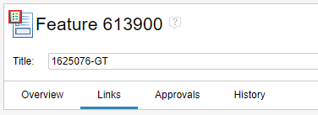

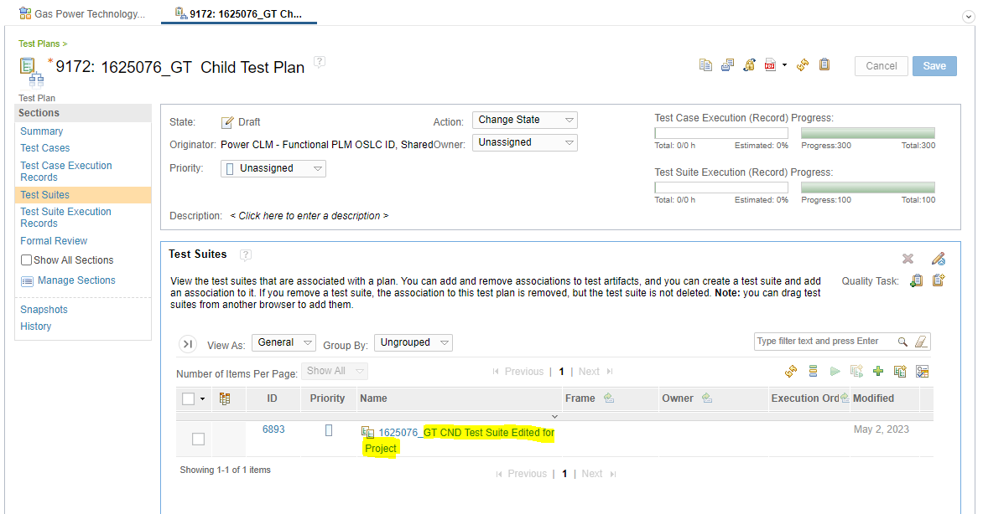
Feature link with Test Plan
1. From the GT Feature, navigate to the Related Test Plan shown in the Links
2. Follow instructions to add applicable FPY test suites to the Child Test Plan

Slide 6
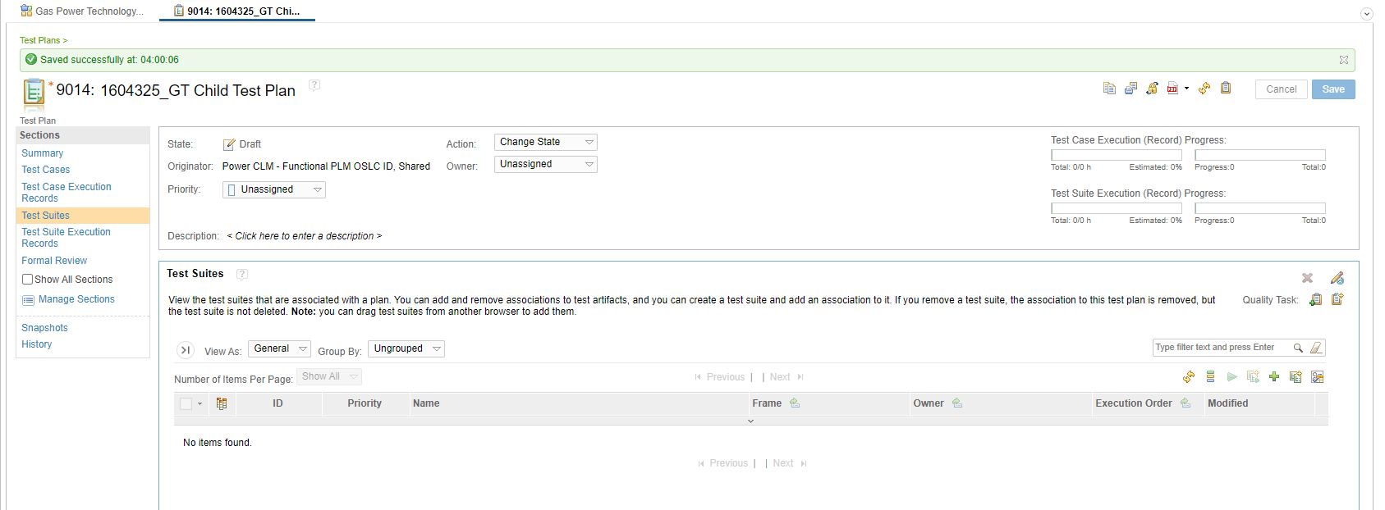
Connect Project Specific Test Suite w.r.t. PBOM/CUD to Plan Summary in CLM
Apply a Standard Test Suite to a Specific Project Test Plan
a. Go to GT Feature and Links, Open the Child Test Plan for the project. (Show in previous slide)
b. Open the project child test plan
c. Go to Test Suites

Slide 7

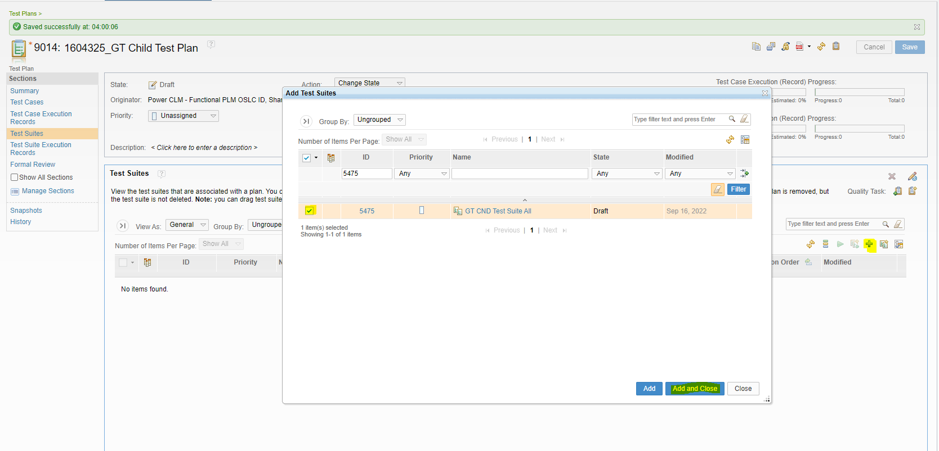
d. Click Add Test Suites
e. Find and select the standard test suite, click Add and Close
f. Click Save

Slide 8
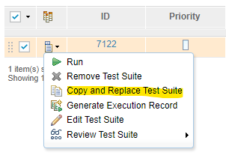
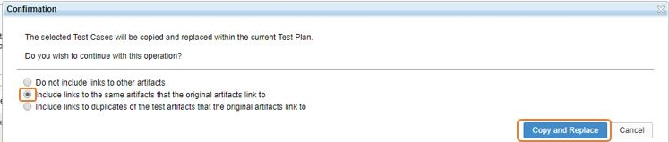
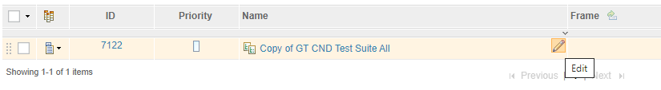
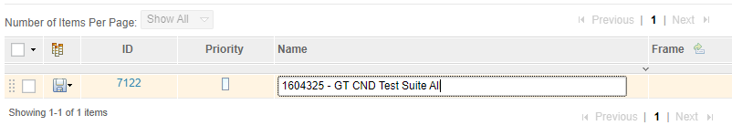
g. Select the checkbox next to the Test Suite
h. Select Copy and Replace from Action Menu
i. Select Include links to the same artifacts that the original artifacts link to, click Copy and Replace
j. Edit the title of the Test Suite by changing “Copy of” to IPS/FDM number and be sure to remove the work "Standard" if it exists

Slide 9
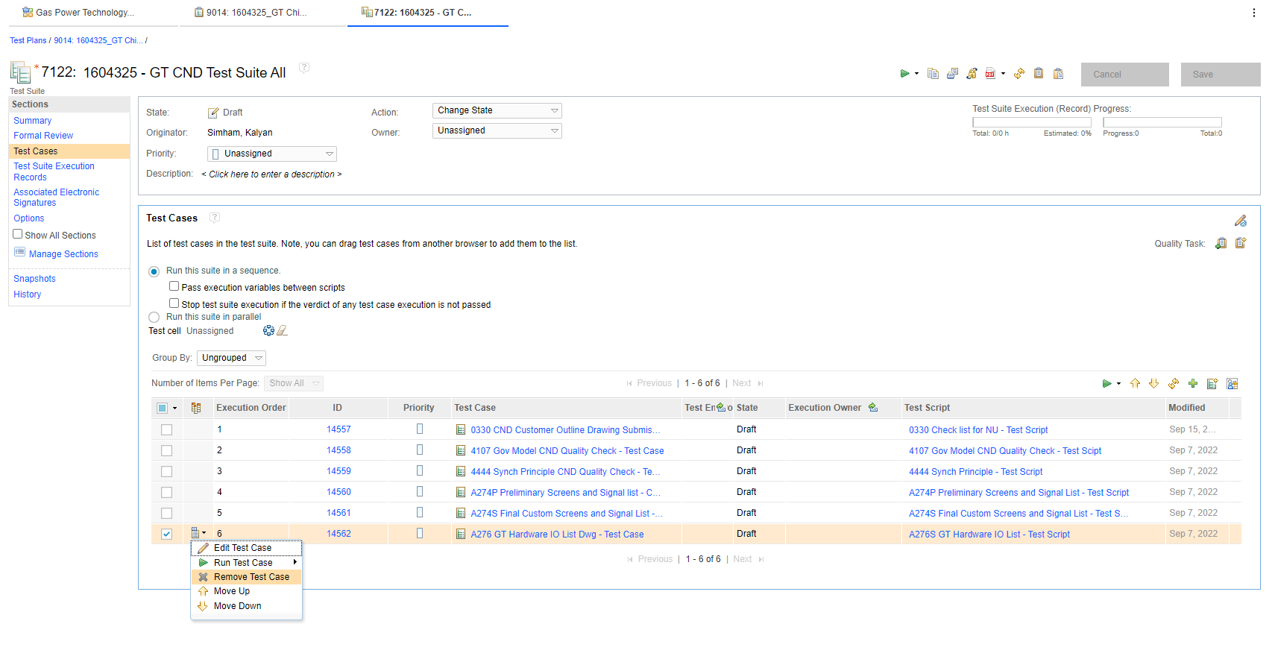
3. Open the Newly create test suite.
Customize the Test cases as per project PBOM/CUD Definition.
Delete the Test cases that are not applicable for the project.

Slide 10
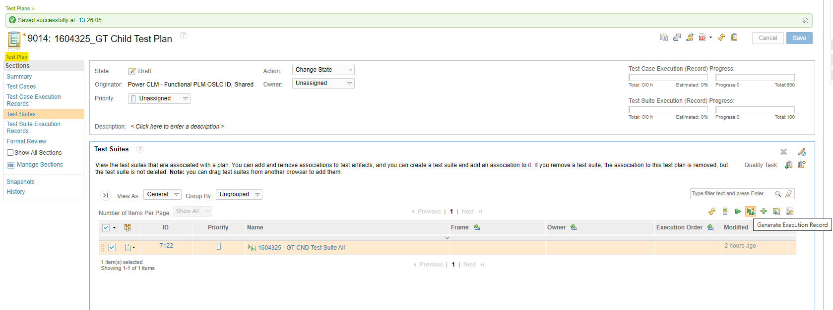
How to Create Test Suite Execution Record For Desired Test Suite
i) Select Test Suites section
ii) Check the box next to the test suite
iii) Click the Generate Execution Record Button

Slide 11
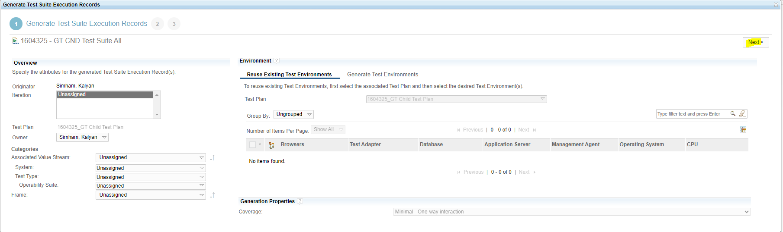
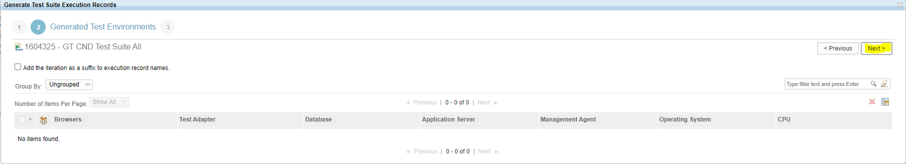
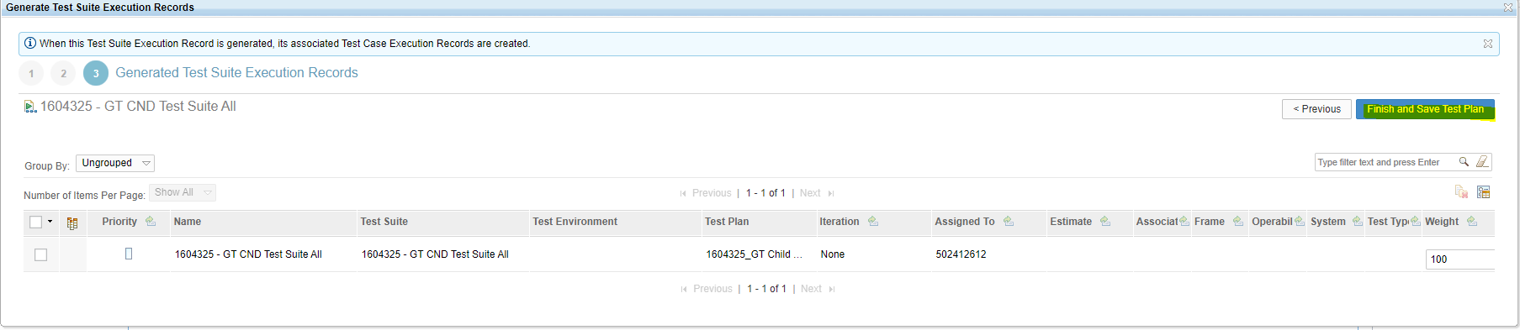
This will open pop-up for Generating Execution record
iv) Click Next
v) Click Next
vi) Click Finish and Save Test Plan

Slide 12
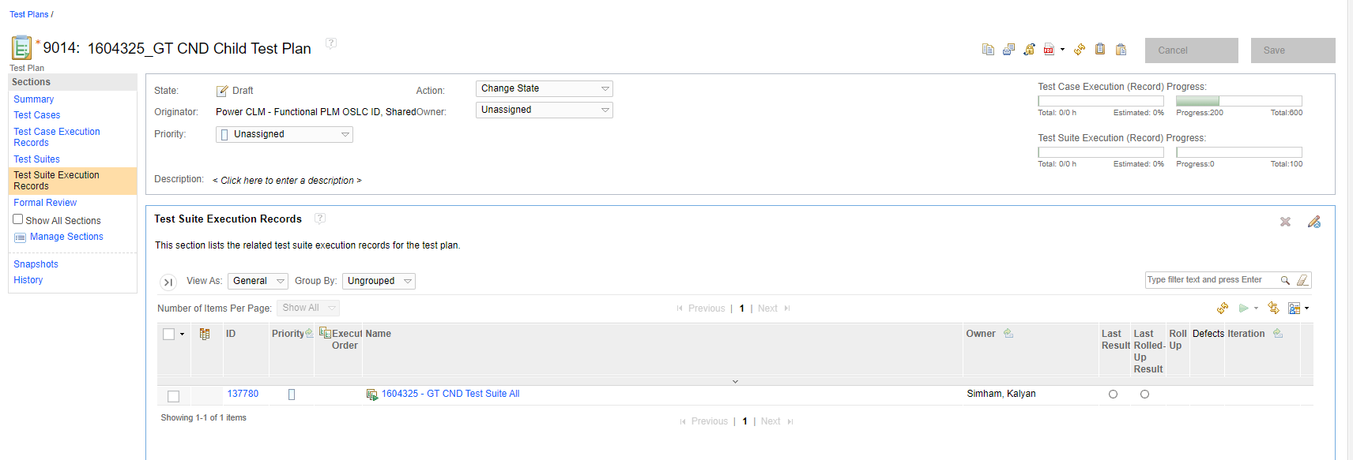
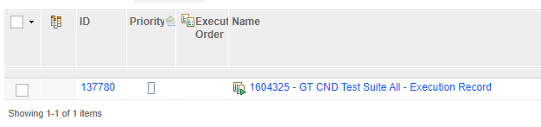
vii) Go to Test Suite Execution Records tab
vii) Rename the Execution record

Slide 13
Running Test in RQM

Slide 14
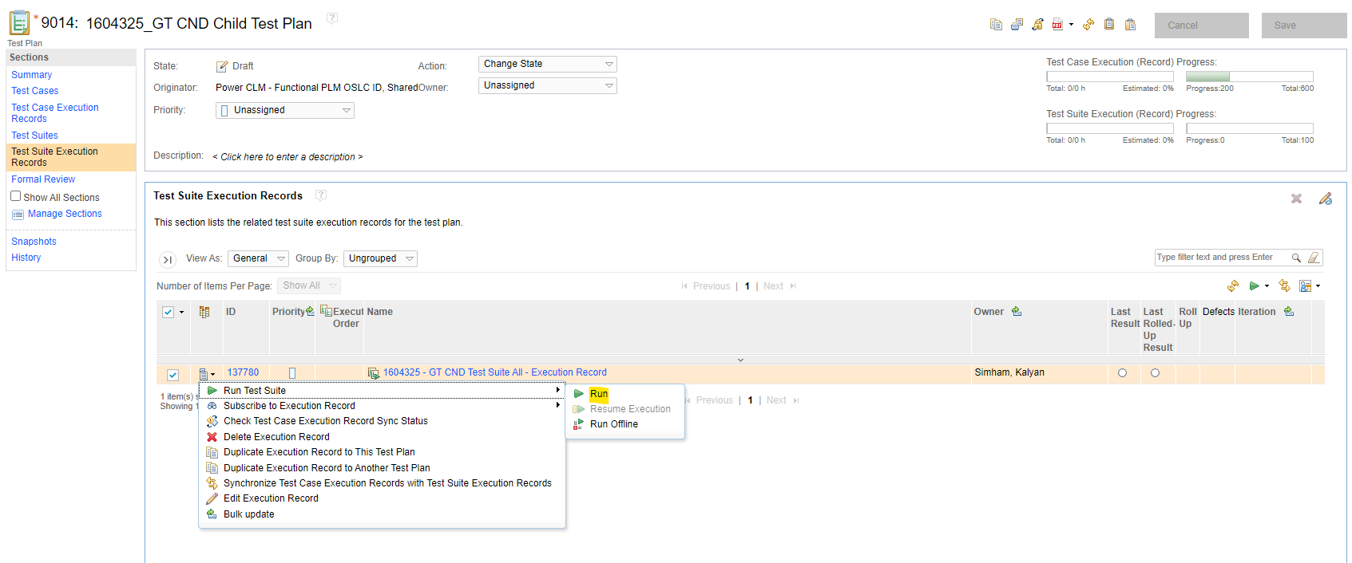
Running Test From Execution Records
Go to Test Suite Execution Records
2) Select the test Suite check box
3) Open the dropdown menu
4) Run the test case

Slide 15
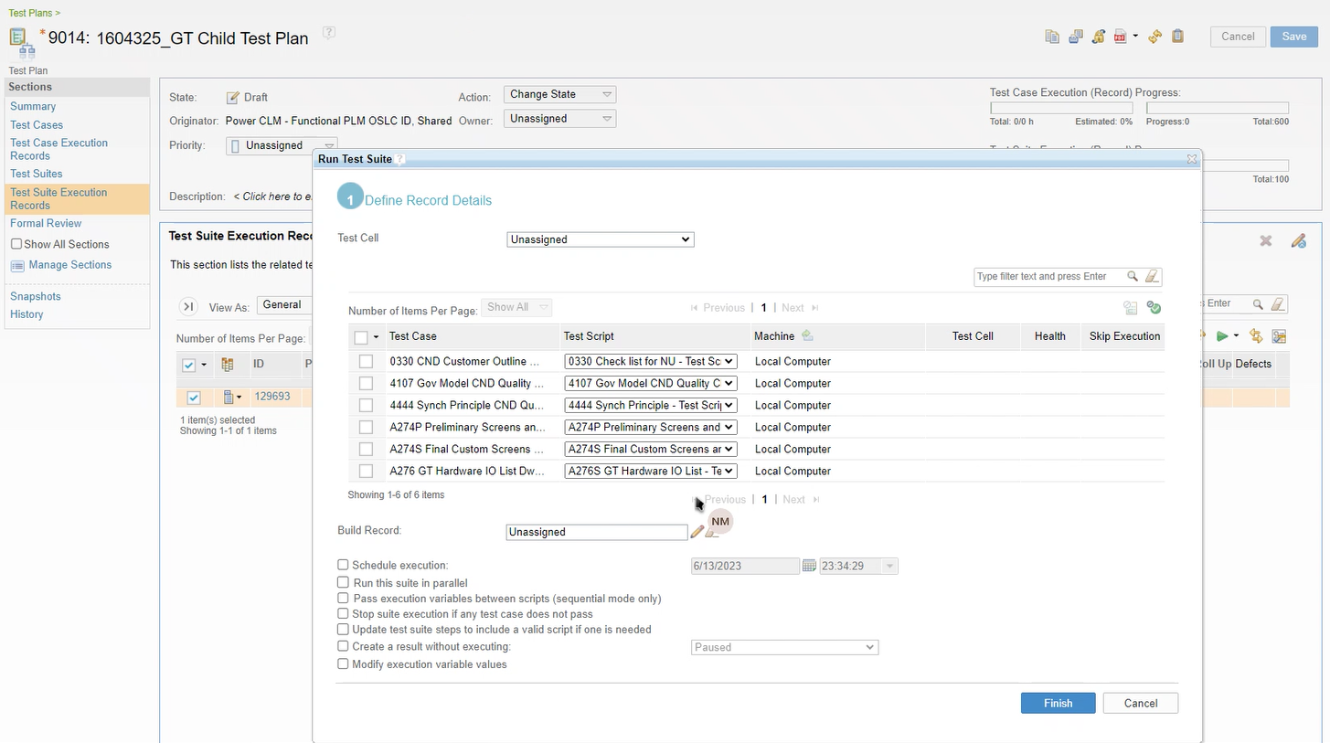
4) This will open window for Running test Suite

Slide 16
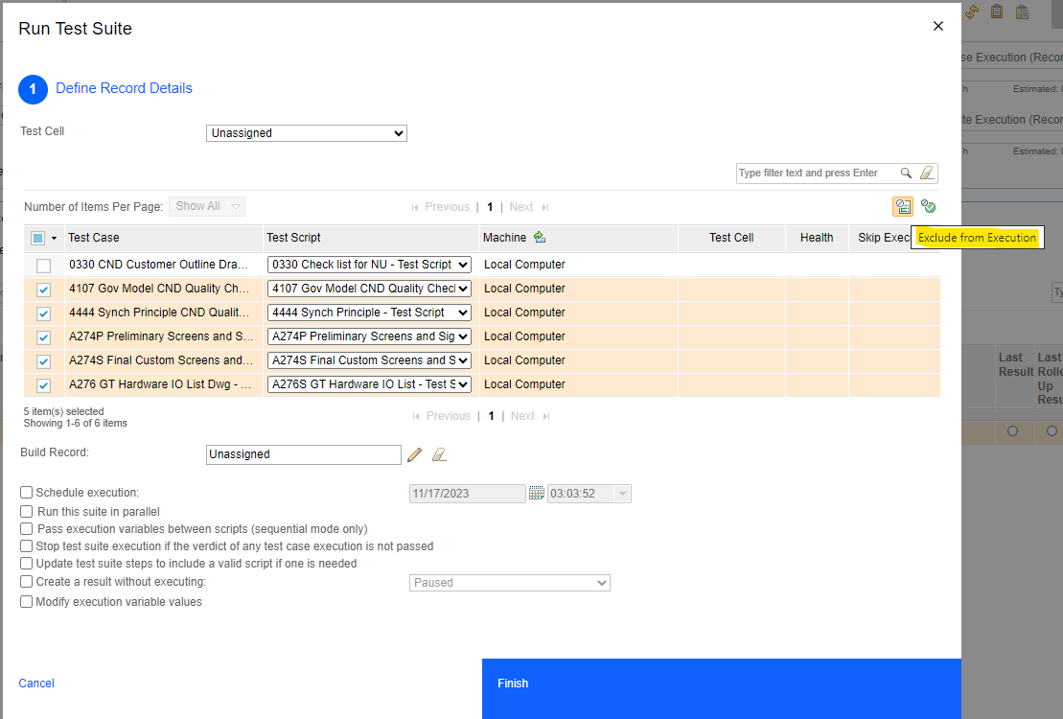
6) Select Exclude from Execution
5) Select test case that are to be exclude from execution.
7) Finish to Run only non selected test case

Slide 17
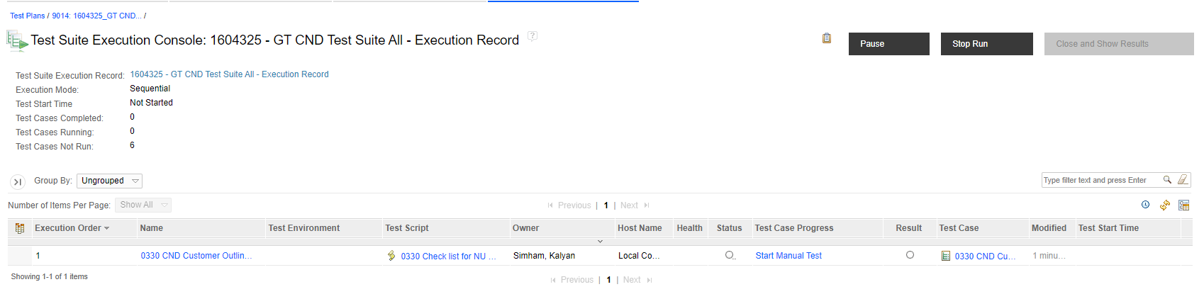
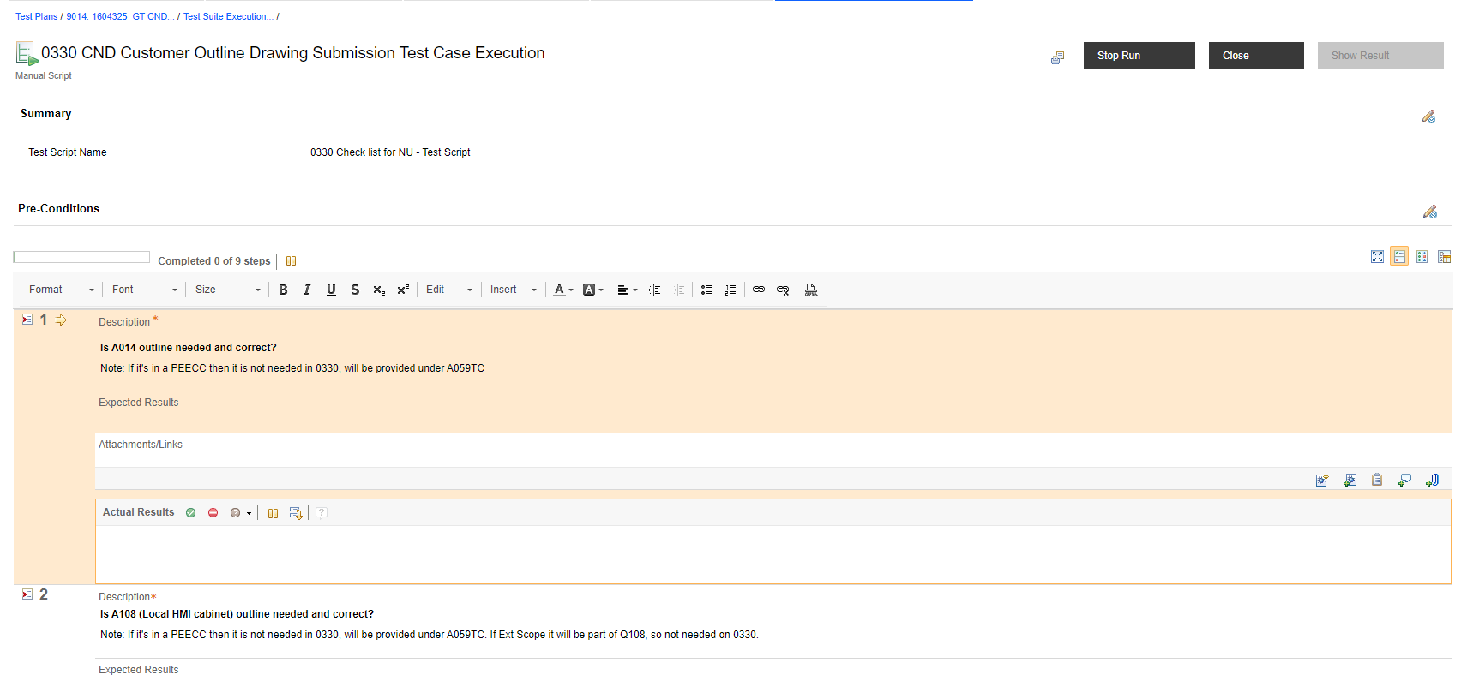
8) Start manual Test for running the case
9) Process all the question in test case, add required comments and passed/failed/skipped results
(Add attachment if applicable)

Slide 18
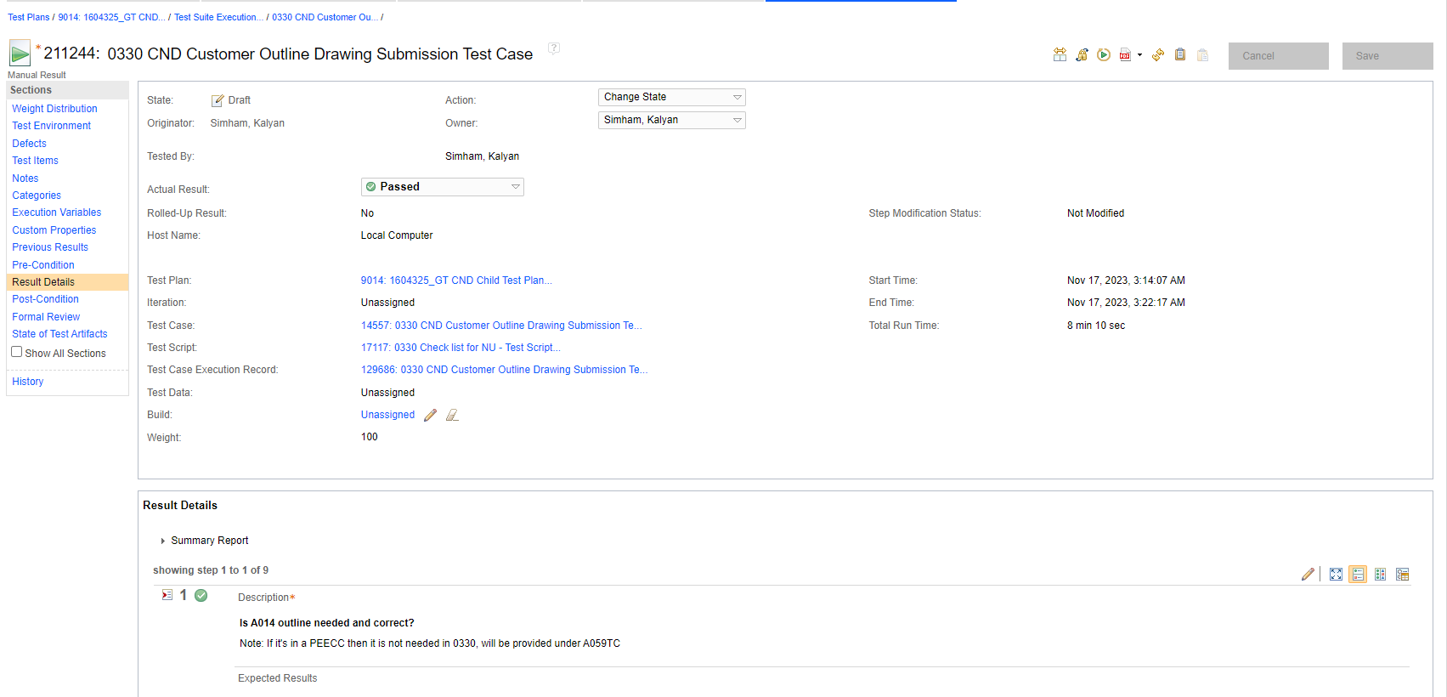
10) After running the case, it will show the result page as shown below.

Slide 19
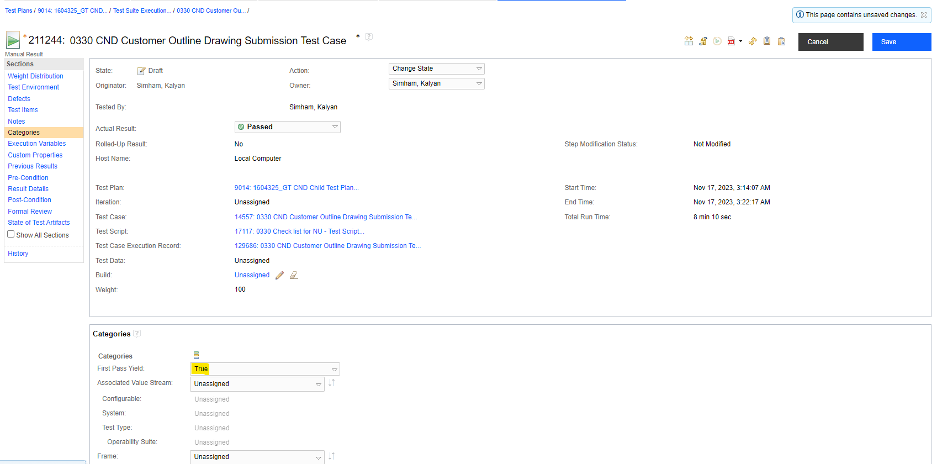
11) Go to Categories section and Change the First Pass Yield as “True”
Note: This is important step, if don’t select it as True, and Save the results will not show the result in Query.
13) Save the Section
12) Update this to “True”

Slide 20
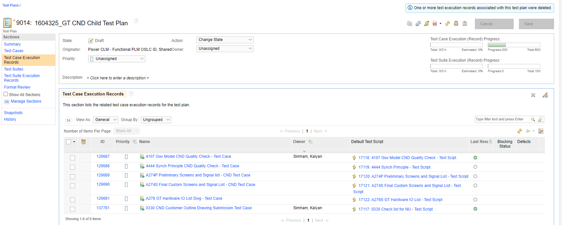
From the Child test Plan go to section “Test Case Execution records” to see all the Cases and status of the execution.
Note: Please don’t delete any records. Retrieving deleted records is not possible.

Slide 21
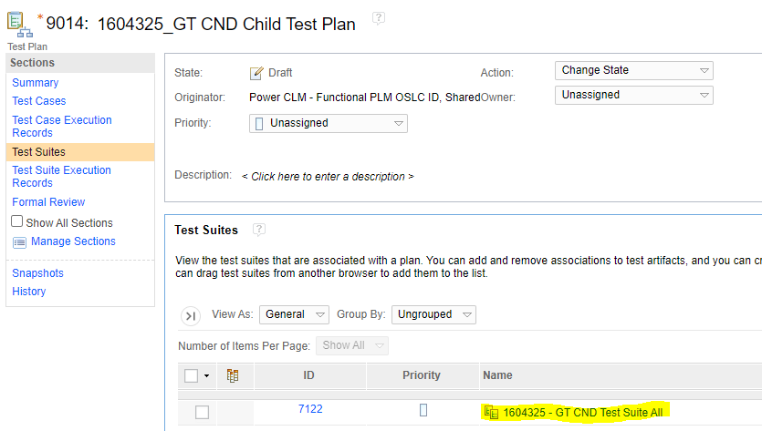
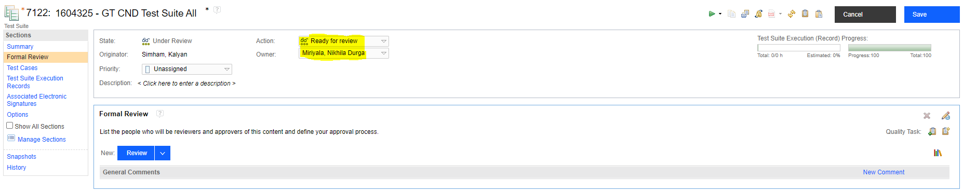
Setting Additional Reviewers or Approvers for Test Suite
This is optional, Discuss with your PO.
1) After Running the all test cases.
2) Go to the Test Suite
3) Open the Test Suite
4) Select Formal Review
5) Set “Ready for Review”
6) Save

Slide 22
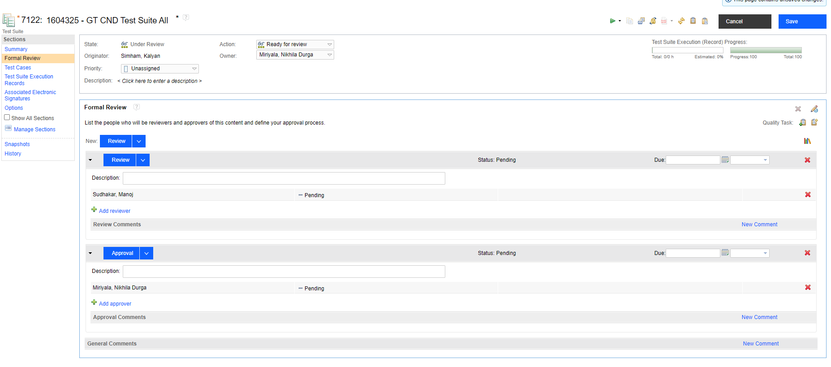
Add Reviewers or Approvers to the list as needed after the all the cases are completed.
9) Save
7) Add Review
8) Add Reviewer
7) Or/and Add approval
8) Or/and Add Approver

Slide 23
Reference
GT Services First Pass Yield (FPY) is located in following link, please use this for reference if needed.
GT Services First Pass Yield (FPY) - Gas Power Engineering Function-specific Process Documentation - Confluence (ge.com)
CLM Rational Quality Manager (RQM) User Guide
CLM Rational Quality Manager (RQM) User Guide - Gas Power Engineering Function-specific Process Documentation - Confluence

